Slide 1
S-03A To Resolve DP Non-Display Issue via DP Retimer FW Update in Shell
NVL-S
Suggested Rework Document

Slide 2
S-03A
To Resolve DP Non-Display Issue via DP Retimer FW Update in Shell
Change Log | 2025 WW31.2 : Initialized 2025 WW32.5 : Adding more detailed statement for the troubleshooting
Description | As the DP Retimer vendor mistakenly flashed the wrong FW on some parts used in certain NVL-S RVPs, a DP non-display issue has occurred. To resolve this issue, a FW update is required. This rework document provides step-by-step instructions for updating the DP Retimer FW on the affected boards. Note: If you have one S01x board with two non-display DP ports, you may need a TCSS TBT modular AIC, a discrete graphics card, or a UART COM port via the microUSB connector to provide display output for executing the FW update process in Shell.
Impact | N/A (No physical rework is needed)
Rework Involved | A USB drive, DP Retimer FW and I2C FW Update Tool
SKUs | S011/S012/S022/S031
Contacts | Lai, Kenneth ; Lin, Nick1 ; Liu, Yuan Erh
HSD Link | https://hsdes.intel.com/appstore/article-one/#/article/22021426784
Collateral Link | NVL-S_ANX7498_UEFI I2C FW Update Tool
SW Dependency | Please make sure I2C5 is enabled in BIOS Setup Menu for DP Retimer FW Update execution

Slide 3
S011/S012

Slide 4
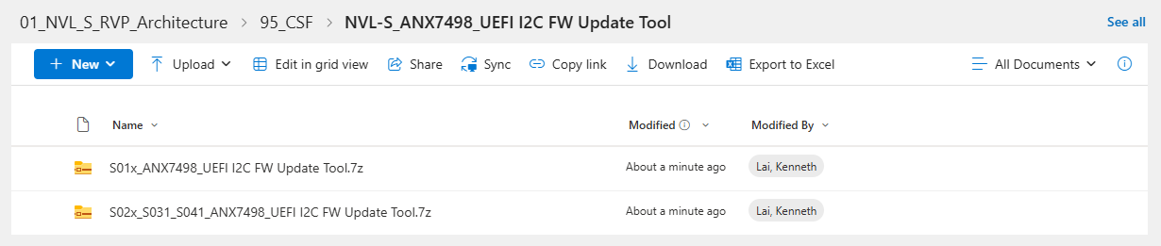
S011/S012
To Resolve DP Non-Display Issue via DP Retimer FW Update in Shell
Step.1 : Go to NVL-S_ANX7498_UEFI I2C FW Update Tool for fetching the needed ingredients in your USB drive for DP2.1 Retimer FW updating
(Unzip the .7z file and plug your USB drive into the SUT)

Slide 5
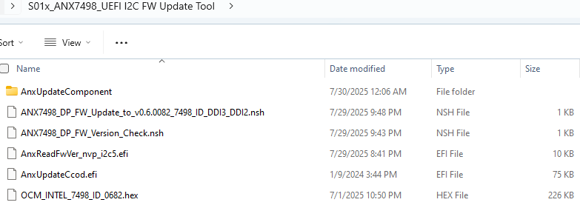
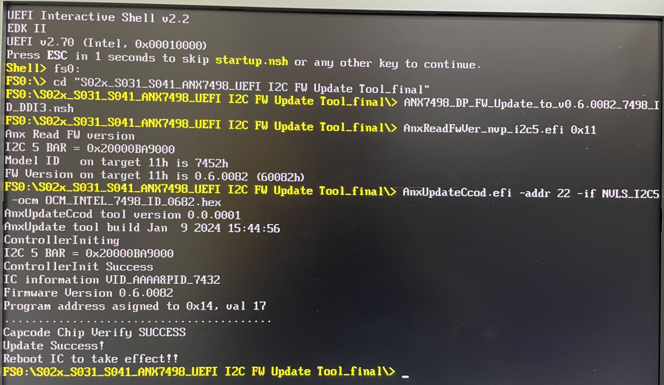
S011/S012
To Resolve DP Non-Display Issue via DP Retimer FW Update in Shell
Step.2 : Boot up SUT to Shell and execute
ANX7498_DP_FW_Update_to_v0.6.0082_7498_ID_DDI3_DDI2.nsh
(In the affected boards, the Model ID will be read as 7452 instead of 7498)
The execution picture just for an example:

Slide 6
S011/S012
To Resolve DP Non-Display Issue via DP Retimer FW Update in Shell
Step.3 : Shut down SUT or power off PSU to finish the FW update process

Slide 7
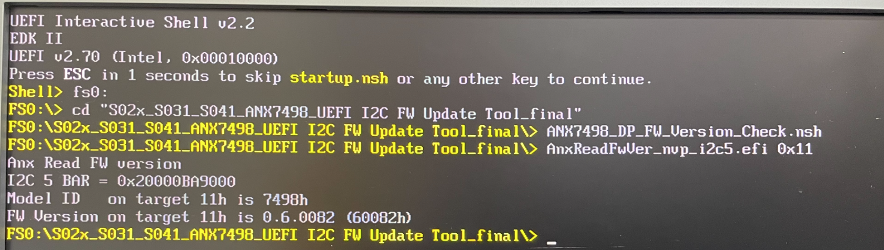
S011/S012
To Resolve DP Non-Display Issue via DP Retimer FW Update in Shell
Step.4(optional) : Boot up SUT to Shell and execute
ANX7498_DP_FW_Version_Check.nsh
(After the FW update process, the Model ID will be correctly read as 7498)
The execution picture just for an example:

Slide 8
S022/S031

Slide 9
S022/S031
To Resolve DP Non-Display Issue via DP Retimer FW Update in Shell
Step.1 : Go to NVL-S_ANX7498_UEFI I2C FW Update Tool for fetching those needed ingredients in your USB drive for DP2.1 Retimer FW updating
(Unzip the .7z file and plug your USB drive into the SUT)

Slide 10
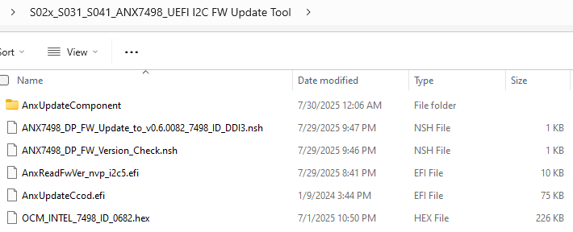
S022/S031
To Resolve DP Non-Display Issue via DP Retimer FW Update in Shell
Step.2 : Boot up SUT to Shell and execute
ANX7498_DP_FW_Update_to_v0.6.0082_7498_ID_DDI3.nsh
(In the affected boards, the Model ID will be read as 7452 instead of 7498)
The execution picture just for an example:

Slide 11
S022/S031
To Resolve DP Non-Display Issue via DP Retimer FW Update in Shell
Step.3 : Shut down SUT or power off PSU to finish the FW update process

Slide 12
S022/S031
To Resolve DP Non-Display Issue via DP Retimer FW Update in Shell
Step.4(optional) : Boot up SUT to Shell and execute
ANX7498_DP_FW_Version_Check.nsh
(After the FW update process, the Model ID will be correctly read as 7498)
The execution picture just for an example:

Slide 13
Troubleshooting

Slide 14
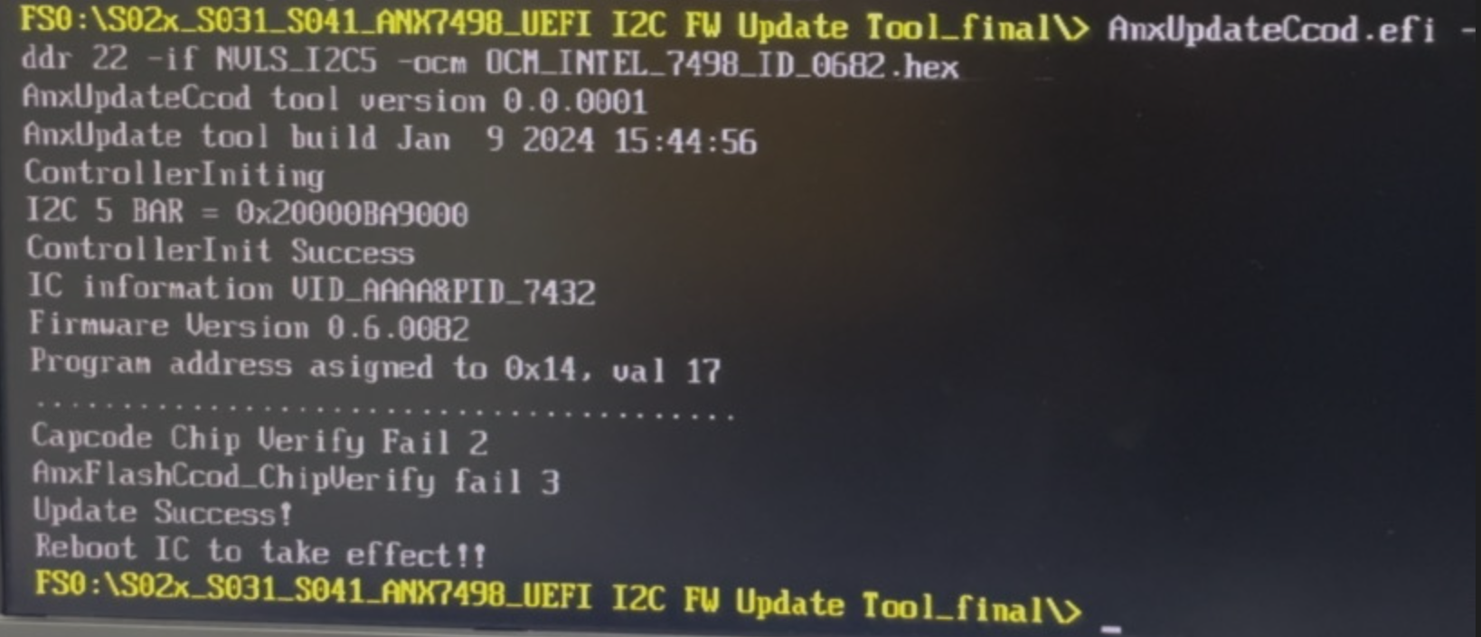
S011/S012/S022/S031
To Resolve DP Non-Display Issue via DP Retimer FW Update in Shell
Note: If a "Fail" message appears during the FW update, the process was unsuccessful. Please do a cold-boot power cycle (power off and power on SUT) and try the FW update procedure again. Sometimes it might need 3 or 4 times to get successful without any “Fail”. This “Verify Fail” problem is under debugging currently.
The failing execution picture just for an example:

